Slide 1
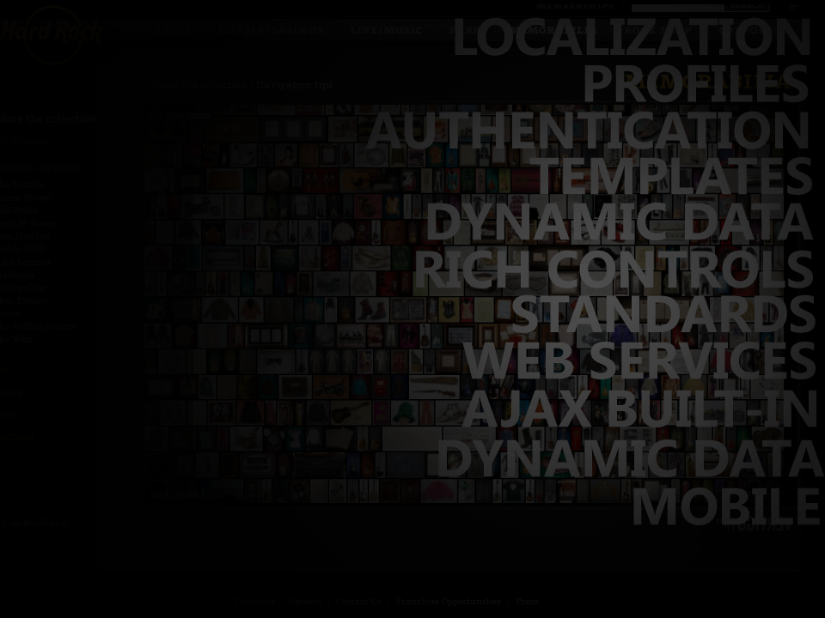
ctrl f5

Slide 2
Clark Sell

Slide 3


Slide 4

developer evangelist

Slide 5

csell.net

Slide 6


Slide 7


Slide 8

@csell5

Slide 9

bitbucket.org/csell5/demos

Slide 10


Slide 11
hopefully

Slide 12


Slide 13


nuggets

Slide 14
the process of incorporating third party libraries is now just 1 command….

Slide 15
it can be
PM> install-package urlshortener.helper

Slide 16
introducing

Slide 17
outline
What is NuGet?
How to get setup?
How to find a package?
How to install a package?
How to update a package?
How to create a simple package?
How to host a simple repository?

Slide 18

Notes:
http://www.flickr.com/photos/spyndle/2422552640/

Slide 19


Slide 20



NPack

Slide 21
What is nuget?
NuGet is a free, open source developer focused package management system for the .NET platform intent on simplifying the process of incorporating third party libraries into a .NET application during development. NuGet is a member of the ASP.NET Gallery in the Outercurve Foundation.
http://nuget.codeplex.com
http://nuget.org

Slide 22
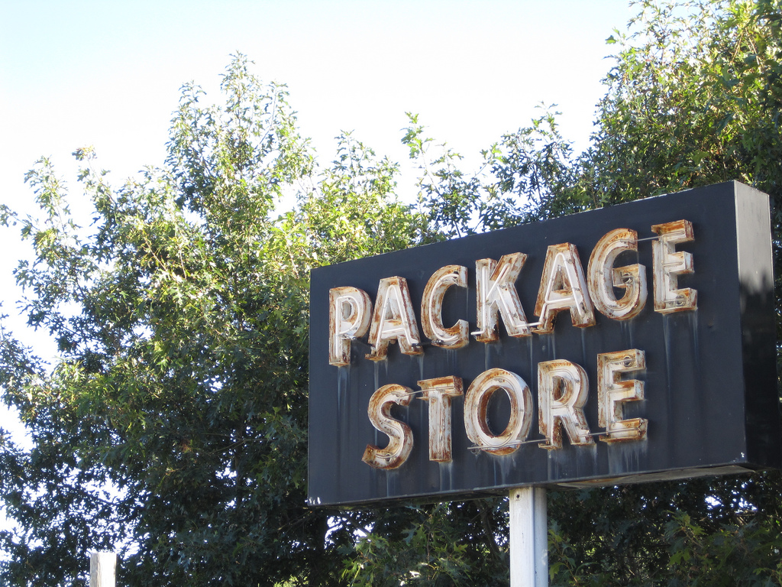
http://www.flickr.com/photos/peretzpup/3925494459/
Notes:
Simply put, a 3rd party library store for use a development time.

Slide 23
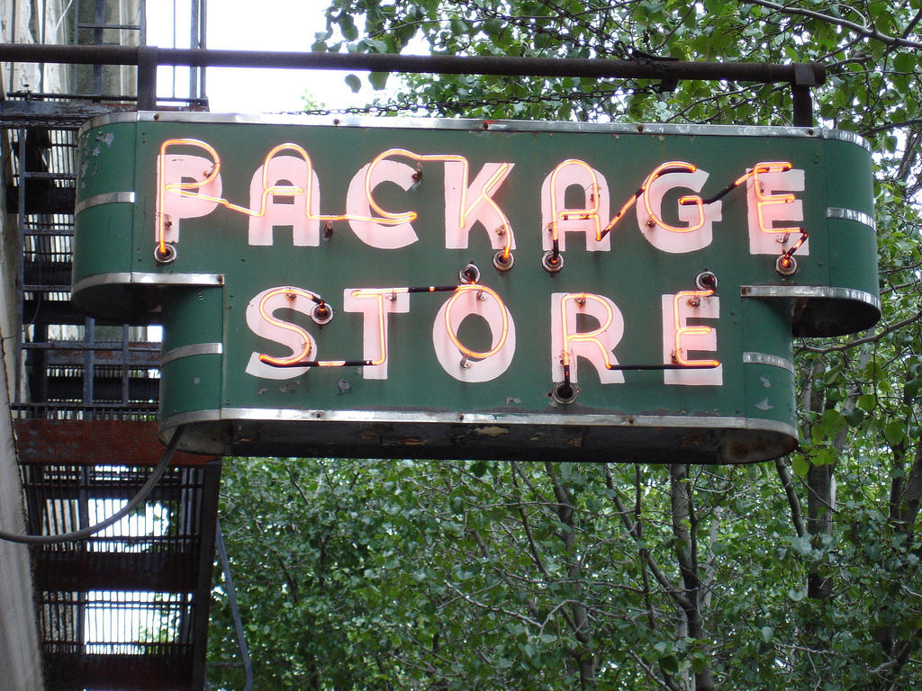

Slide 24
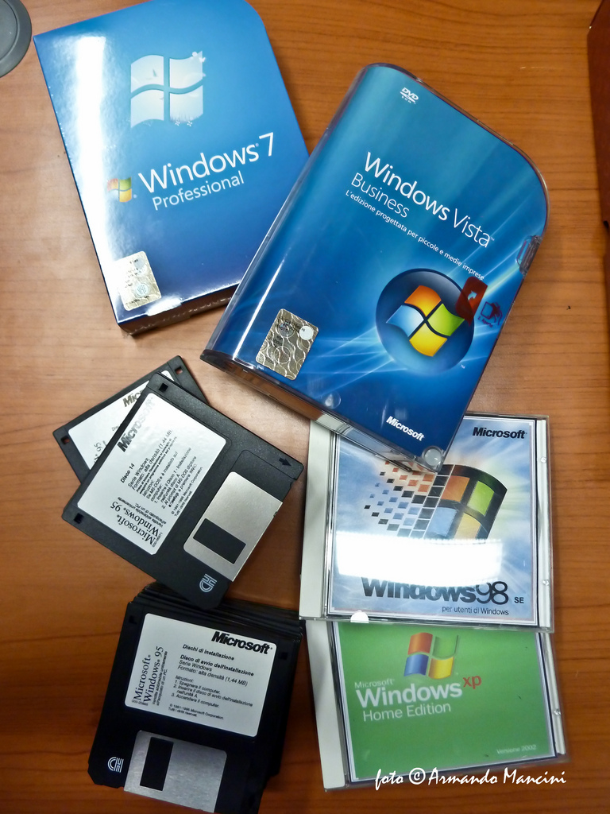

Slide 25
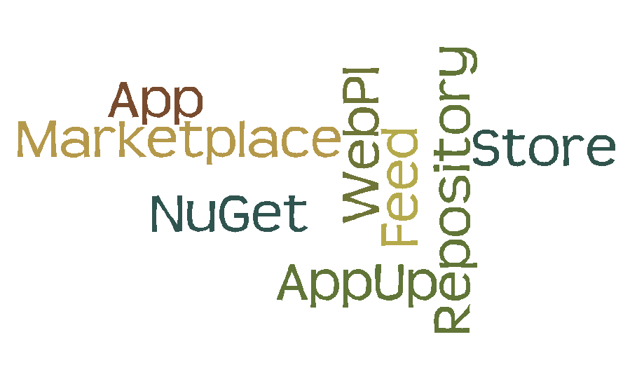
http://Wordle.net
Notes:
What kind of pacakges

Slide 26
as developers
Getting packages
Publishing packages
Hosting packages
HOST
Get
Push

Slide 27
distribution methods
WebPI
VS Ext Mgr
nuget
EXE or MSI

Slide 28
distribution methods
WebPI
VS Ext Mgr
NuGet
EXE, MSI

Slide 29
Choice is affected by context.
Yoon et al. (2008). Choice Set Configuration as a Determinant of Preference Attribution and Strength. Journal of Consumer Research
www.journals.uchicago.edu/doi/abs/10.1086/587630

Slide 30
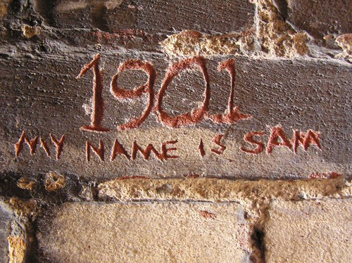
Notes:
http://www.flickr.com/photos/pupski/42624981/

Slide 31


Slide 32


Slide 33
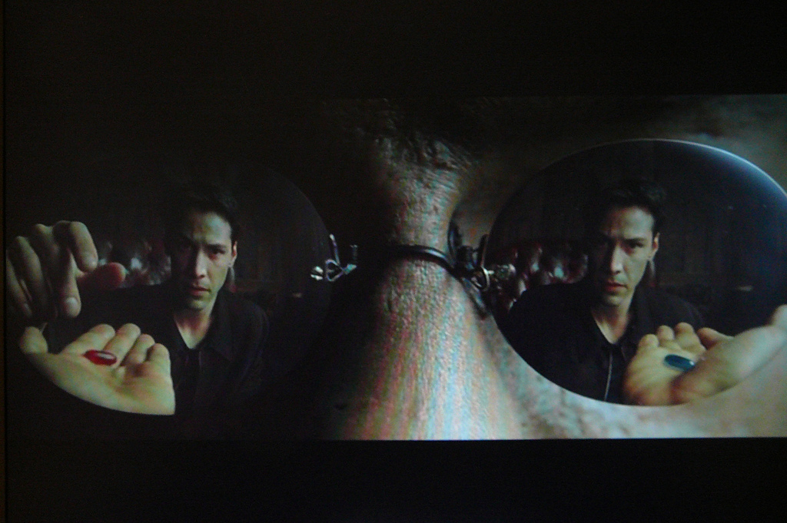

Slide 34

http://www.flickr.com/photos/spyndle/5047889128/

Slide 35
.exe, .msi, .zip
Installed to Operating System
Lots of choices
Usually chained with other packages
Stands and installs by itself
No native distribution channel
No free marketing
Manual Updates, ie need another package and user input
Examples packages:
WebPI
Visual Studio
Office

Slide 36
WebPI
Catalogue of products
Install stands on it’s own
Packages install to operating system
Install through WebPI distribute channel
Installation Simplified
Drive by, Marketing
Example Packages:
WebPI
MVC
IIS Modules
WordPress

Slide 37
VS extension manager
Part of Visual Studio
Packages install into Visual Studio
Packages are targeted to augmenting the development experience
Automatic updating
Drive by marketing
Example packages include
nuget
Visual Studio Powertools
JetBrains Resharper

Slide 38
nuget
Packages are usually “libraries”
Packages are meant to be developed against
Multiple hosting strategies
Channel = Web
Drive by marketing
Easy tooling integration with things like Visual Studio, WebMatrix
Example packages:
ELMAH
Entity Framework
SQL Compact
UrlShortenerHelper

Slide 39
OS
nuget
VS Extension Manger
WebPI
EXE or MSI
Developer
WebPI
Visual Studio
IIS Modules
Orchard
ReSharper
nuget
Elmah
EF

Slide 40
architecture breakdown
Command Line, Visual Studio, WebMatrix, Applications
Interface
NuGet
Core, Dialog or Interface, Server
Object Model
NuGet.org
Custom
Server \ Feed

Slide 41
interacting with the prompt
Command -> Verb-Noun
PM> Get-Package -remote
PowerShell Command Prompt
Argument

Slide 42
installing
3 main methods
Visual Studio Extension Manager
NuGet, http://NuGet.org
Bundled with something else, i.e Microsoft’s WebMatrix
Notes:
The install

Slide 43
Commands
Find -> list-package [ package name ]
Install -> install-package [ package name ]
Update -> update-package [ package name ]
Notes:
http://Nuget.org
Start with the tooling window to show the package manager setting and feeds.
Show the package manager console window
Show the “Add Library Package” Reference Dialog
Console Commands:
get-package
Get-package –remote
Get-package –filter

Slide 44

demo
Package Manager

Slide 45

.nupkg
A .nupkg file is a structured ZIP file of which contains all of the assets to be installed by NuGet framework.

Slide 46
package breakdown
\Name
\Version
\content - These files will be copied to the site root on install
\Readme.txt
web.config.transform
Lib - dlls under this folder become assembly references on install
\MyCommonAssembly.dll { all framework versions }
\Net35 { Framework Name }{ Version }
\MyAssembly.dll
\Net40
\MyAssembly.dll
\xxx.Nuspec

Slide 47
.nuspec
<?xml version="1.0"?>
<package xmlns:xsi="http://www.w3.org/2001/XMLSchema-instance"
xmlns:xsd="http://www.w3.org/2001/XMLSchema">
<metadata xmlns="http://schemas.microsoft.com/packaging/2010/07/nuspec.xsd">
<id>UrlShortener.Helper</id>
<version>0.9.1</version>
<authors>Clark Sell</authors>
<licenseUrl>http://urlshortenerhelper.codeplex.com/license</licenseUrl>
<projectUrl>http://urlshortenerhelper.codeplex.com</projectUrl>
<requireLicenseAcceptance>false</requireLicenseAcceptance>
<language>en-US</language>
<description>desc</description>
<summary>summary</summary>
</metadata>
</package>

Slide 48
.nuspec dependencies
<?xml version="1.0" encoding="utf-8"?>
<package>
<metadata>
<id>sample</id>
<version>1.0.0</version>
<authors>Microsoft</authors>
<dependencies>
<dependency id="another-package" version="3.0.0" />
<dependency id="yet-another-package" minversion="2.1.0" />
</dependencies>
</metadata>
</package>

Slide 49
config transforms
\content\web.config.tranform ( or app.config )
It does a merge not a copy
Existing
<configuration>
<system.webServer>
<modules>
<add name="csellModule" type="csell.module" />
</modules>
<system.webServer>
</configuration>
Transform
<…>
<add name="csellNewModule" type="csell.newModule" />
</…>
Resulting
<…>
<add name="csellModule" type="csell.module" />
<add name="csellNewModule" type="csell.newModule" />
</…>

Slide 50
source transforms
Oh yes you can….
Similar to Visual Studio Project Templates
David Ebbo, NuGets with Startup code and WebActivator
http://blogs.msdn.com/b/davidebb/archive/2010/10/11/light-up-your-nupacks-with-startup-code-and-webactivator.aspx
ProjectProperties Properties –
http://msdn.microsoft.com/en-us/library/vslangproj.projectproperties_properties(VS.80).aspx

Slide 51
demo
Creating and host simple NuGet packages

Slide 52
summary
What is NuGet?
How to get setup?
How to find a package?
How to install a package?
How to update a package?
How to create a simple package?
How to host a simple repository?

Slide 53

resources
nuget - nuget.codeplex.com
current nuget package store - nuPackPackages.codeplex.com
nuget gallery server - GalleryServer.codeplex.com
and more…

Slide 54
items to explore
Complex package creation
Config Transforms
Source Transforms
Complex Dependencies
Hosting a NuGet gallery

